Slide 1
pAInITe New Features

Slide 2
Agenda
Introduction
Property file
Monte Media
Enhancement in Reporting and Log File
Suite Files

Slide 3
Introduction
Selenium Webdriver is being used as the core automation engine.
Eclipse IDE is used to develop the automated scripts.
Build tool Maven is used for build, execution and dependency purpose.
TestNG framework is used for organizing the scripts with Groups and Priorities
Test data is read from Excel sheet at run time.
Git and Github is used for version control management.
CI tool Jenkins is used to run the scripts.
Extent, HTML, PDF Reports test results are generated for each run.
Config.Properties file for Constants
Cross Browser Testing using selenium Grid

Slide 4
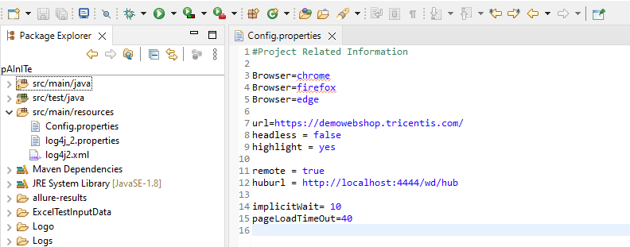
Properties file
This file (config.properties) stores the information that remains static throughout the framework such as browser specific information, application URL, Test Data path etc.
All the details which change as per the environment and authorization such as URL, Login Credentials are kept in the config.properties file. Keeping these details in a separate file makes easy to maintain.

Slide 5
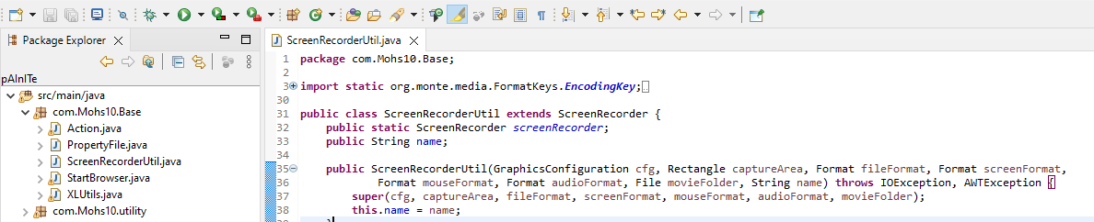
Monte Media Feature
Usually, we take screenshots and include them in reports, like HTML Reports or Extent Reports. This helps us in understanding and fixing test problems and figuring out the cause of test failures.
Yet, there are situations where a video that captures the actual screen changes, transitions, and input produced by your automated tests could be even more helpful. Such a video might also be useful when presenting your work to peers and other stakeholders.
That's where Monte Screen Recorder comes into play. It's a Java library that makes it simple to create videos for your Selenium tests.

Slide 6
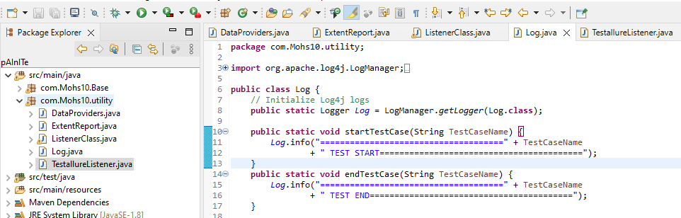
Enhancement in Reporting and Log File
Log File: A log file is like a software diary that notes what's happening. It helps experts understand issues, track actions, and check performance.
Data Provider: This helps us use different sets of data for testing. It's like trying out the same thing with different options to see if everything works well..
Listener Class: In testing, a "listener" is like a watchful helper. It pays attention to what happens during tests, like when they start, finish, or if there are problems. Listeners help make testing better by letting you do special things during tests or gather extra information while they're running.

Slide 7
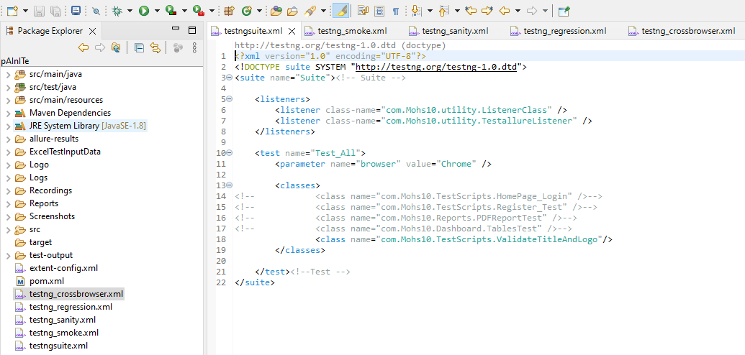
Suite Files
These Suite Files" are sets of organized tests that cover various aspects of an application. These suites include different types of tests like regression, sanity, smoke, and cross-browser testing. By grouping tests this way, testing becomes more efficient and thorough, leading to better software quality.
This approach ensures that a wide range of scenarios are tested, from critical functionality to cross-browser compatibility, contributing to the overall success of the testing efforts.

Slide 8
Thank you
Git Hub Link:
https://github.com/Mohs10/Production/tree/Painite_Aug_2023

